Slide 1
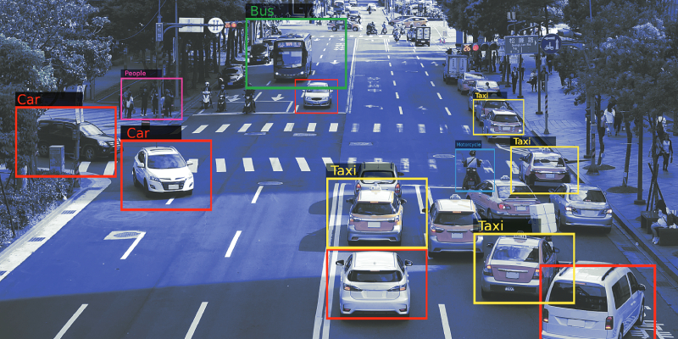
TRAFFIC MANAGEMENT SYSTEM
Guided By:
S. Rajesh

Slide 2
TEAMMATES:- Group 3
K. Harish Kumar (cse) 99220040566
V. Venkata Pavan Kumar (cse) 99220041592
M. Mugesh Kannan (ece) 9823005008
D. Khasim Aman (cse) 99220040496
M. Sai (cse) 99220040622

Slide 3
PROBLEM STATEMENT:-
Traffic congestion is a major issue due to fixed-timer traffic signals, leading to long waiting times, fuel wastage, and increased pollution. Vehicles are often stuck even when the opposite lane is clear, and emergency services face delays. The lack of real-time adaptation in existing systems makes traffic flow inefficient, highlighting the need for an intelligent traffic management system.

Slide 4
INTRODUCTION TO TRAFFIC MANAGEMENT SYSTEM :-
A Traffic Management System (TMS) aims to enhance the efficiency, safety, and environmental sustainability of transportation networks.
By optimizing traffic flow, reducing congestion, and minimizing accidents, a TMS improves overall road safety and lowers emissions
Key components include traffic signals, signs, surveillance cameras, and communication systems, all working together to monitor and manage traffic conditions.

Slide 5
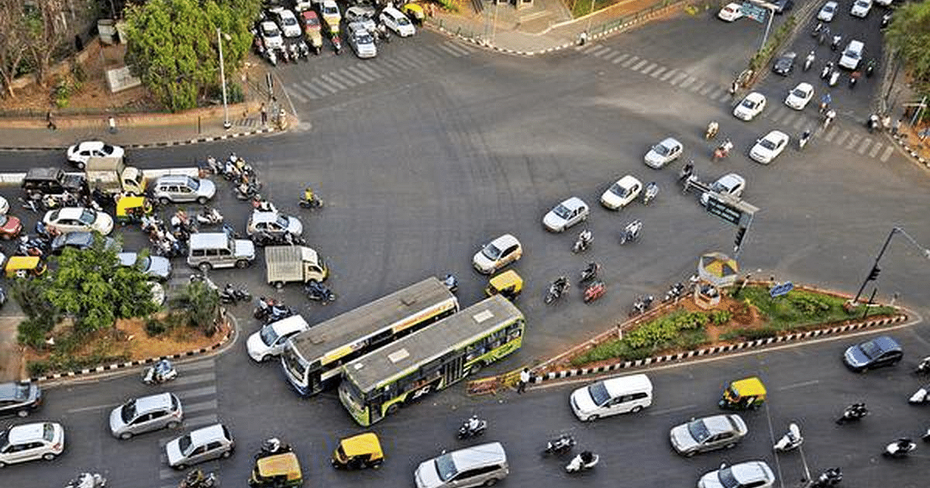
CURRENT CHALLENGES :-
Despite advancements in traffic management technology, several challenges persist.
Increasing complexity of urban transportation networks and the rapid growth of vehicle numbers, which lead to congestion and inefficiencies.
Adapting to diverse and often outdated infrastructure while implementing new technologies like autonomous vehicles and smart traffic lights presents hurdles.

Slide 6
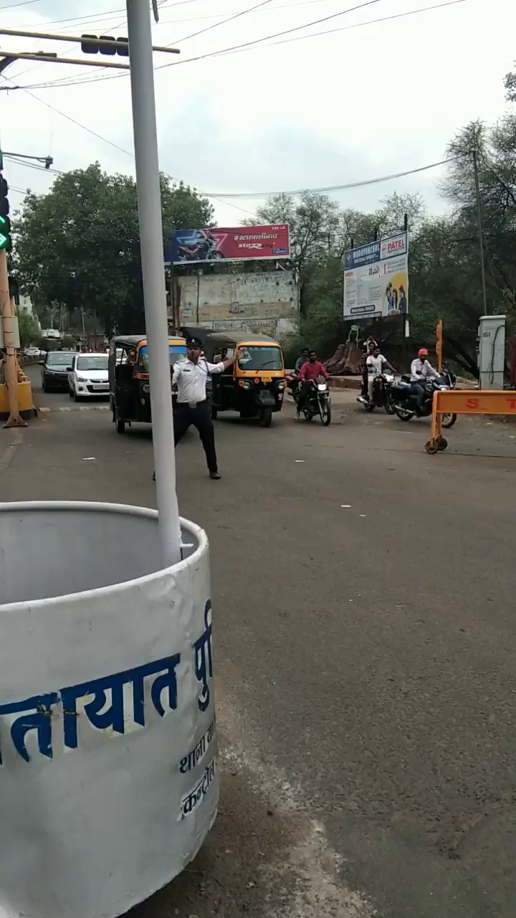
BEFORE :-

Slide 7

SMART TRAFFIC SIGNALS :-
Smart traffic signals enhance traffic management by using real-time data from sensors and cameras to dynamically adjust signal timings and optimize traffic flow.
Implementing smart traffic signals can drastically improve traffic flow. These system utilize real-time data to adjust signal timings based on current conditions, reducing wait times.

Slide 8
SOFTWARE DESCRIPTION :-
YOLO Algorithm for vehicle detection and classification.
OpenCV for image processing and traffic density estimation.
Streamlit for a user-friendly web-based interface.
ESP32-CAM for live video streaming and data collection.
Python for backend processing and system logic.

Slide 9
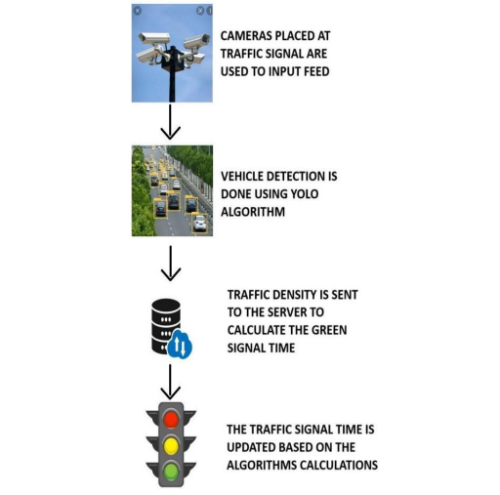
PROPOSED METHODOLOGY :-

Slide 10
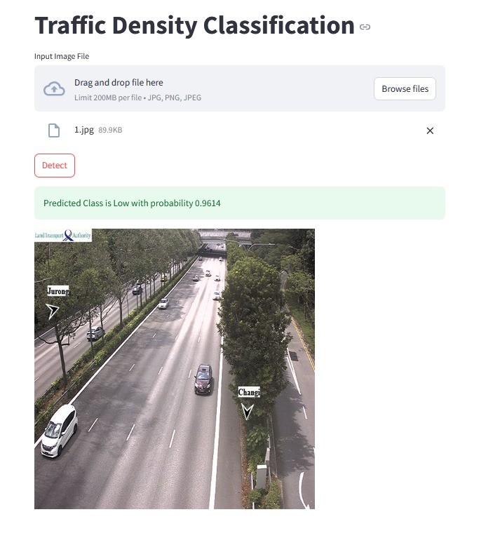
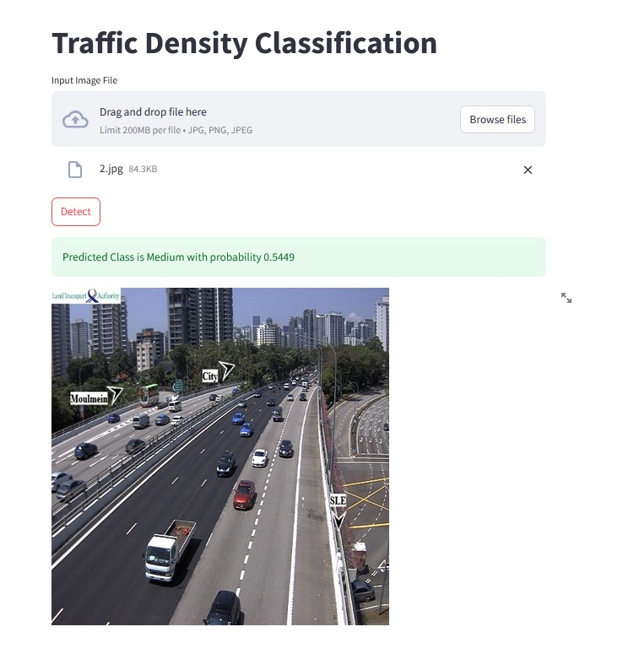
EXECUTION & RESULTS :-

Slide 11
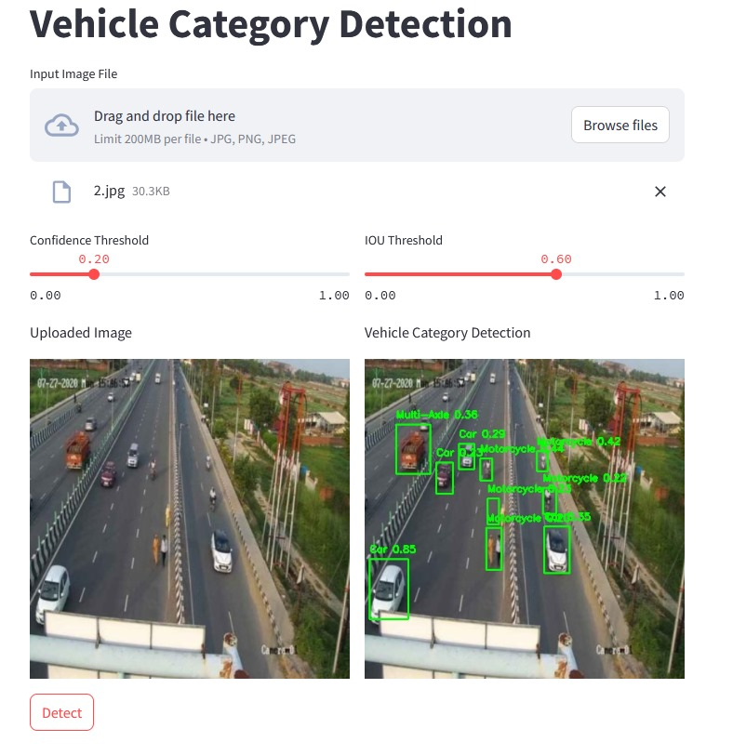
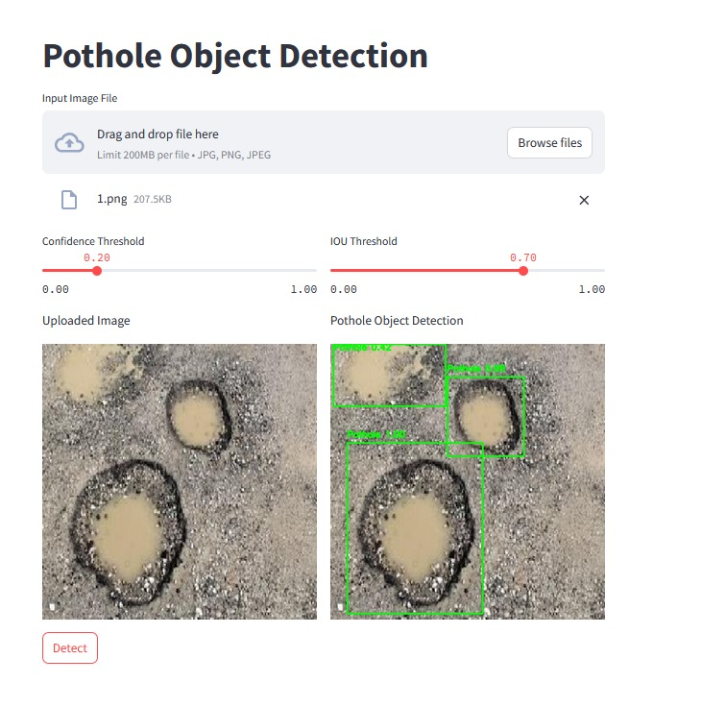
EXECUTION & RESULTS :-

Slide 12
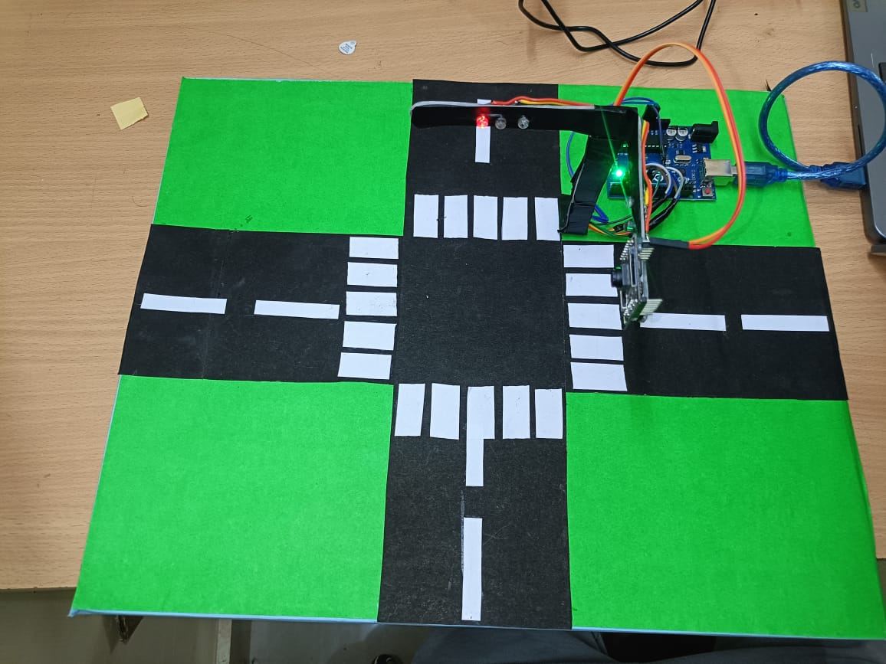
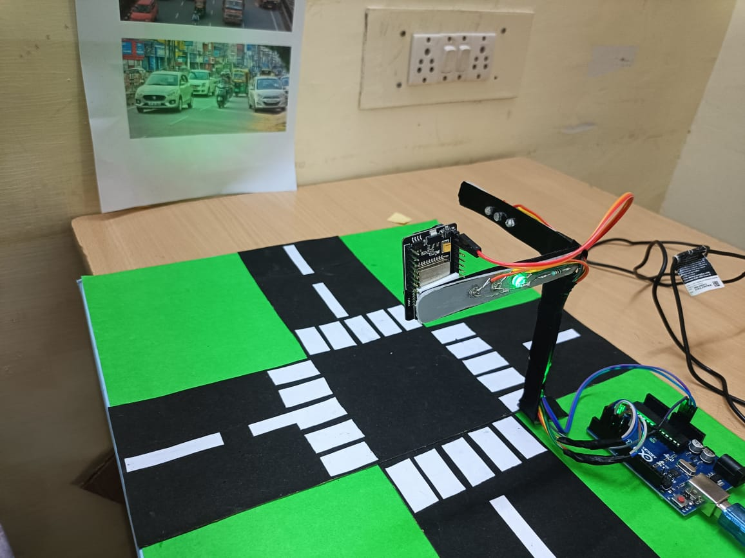
PROTOTYPE :-

Slide 13
COMMUNITY SERVICES:-
Enhanced Traffic Flow: By adjusting signal timings in real time, smart traffic signals help to reduce congestion and prevent traffic jams, leading to smoother and more efficient commutes.
Economic Benefits: Reduced travel time and lower fuel consumption lead to cost savings for drivers and can boost local economies by improving access to businesses and services.

Slide 14
CONCLUSION :-
In conclusion, smart traffic signals represent a significant advancement in traffic management technology.
By leveraging real-time data and adaptive algorithms, they enhance traffic flow, improve safety, and reduce environmental impact.
While the implementation involves substantial investment and technical complexity, the benefits including smoother traffic, reduced congestion, and demonstrate their potential to transform urban transportation systems for the better.

Slide 15


